Slide 1
HL ONLY
TOPIC A1:
COMPUTER FUNDAMENTALS
LESSON A1-1
THE CPU AND GPU

Slide 2

AGENDA
CPU and GPU Observation
Constructing a CPU diagram
Processor Types
The GPU
CPU and GPU differences [HL ONLY]
Lab
WHAT U NEED 4 LESSON
Pycharm
Notes Document

Slide 3

THE WARM UP QUESTION
Construct a Binary Search Tree from the following names and tell me what the preorder and postorder traversal outputs are:
John, Jamie, Josh, Joey, Jerry, Jerome, Jack, Jaul

Slide 4
















THE WARM UP ANSWER

Slide 5
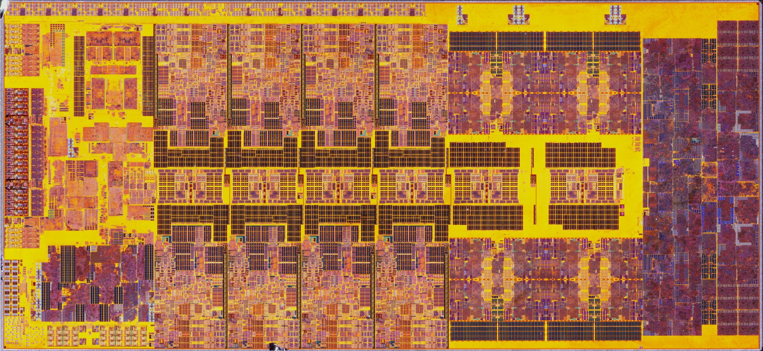
CPU VS GPU OBSERVATION
This is an Intel Core i9-13900K, a CPU
https://cdn.wccftech.com/wp-content/uploads/2022/10/Intel-13th-Gen-Raptor-Lake-Core-i9-13900K-CPU-Die-Shots-_5-scaled.jpg

Slide 6
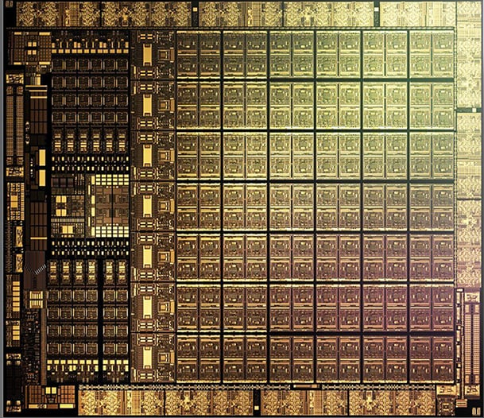
CPU VS GPU OBSERVATION
And this is a GeForce RTX 3050, a GPU
https://images.hothardware.com/contentimages/article/3176/content/small_nvidia-ga106-gpu-die.jpg

Slide 7
CPU VS GPU OBSERVATION
Thoughts, observations?
https://images.hothardware.com/contentimages/article/3176/content/small_nvidia-ga106-gpu-die.jpg

Slide 8
CPU VS GPU OBSERVATION
Describe the CPU’s structure in a sentence. What does it look like?
https://images.hothardware.com/contentimages/article/3176/content/small_nvidia-ga106-gpu-die.jpg

Slide 9
CPU VS GPU OBSERVATION
Describe the GPU’s structure in a sentence. What does it look like?
https://images.hothardware.com/contentimages/article/3176/content/small_nvidia-ga106-gpu-die.jpg

Slide 10
CPU VS GPU OBSERVATION
Describe similarities and differences between the CPU and GPU layout
https://images.hothardware.com/contentimages/article/3176/content/small_nvidia-ga106-gpu-die.jpg

Slide 11
CPU VS GPU OBSERVATION
The CPU is separated into unique segments, or blocks, and the GPU is a dense, repeating grid
https://images.hothardware.com/contentimages/article/3176/content/small_nvidia-ga106-gpu-die.jpg

Slide 12
CONSTRUCTING A CPU DIAGRAM
Follow along with me as we construct a CPU diagram, feel free to do this on the table and take a picture, or do it use shapes in your notes doc, up to you.
https://images.hothardware.com/contentimages/article/3176/content/small_nvidia-ga106-gpu-die.jpg

Slide 13
CONSTRUCTING A CPU DIAGRAM
Follow along with me as we construct a CPU diagram, feel free to do this on the table and take a picture, or do it use shapes in your notes doc, up to you.
https://images.hothardware.com/contentimages/article/3176/content/small_nvidia-ga106-gpu-die.jpg

Slide 14
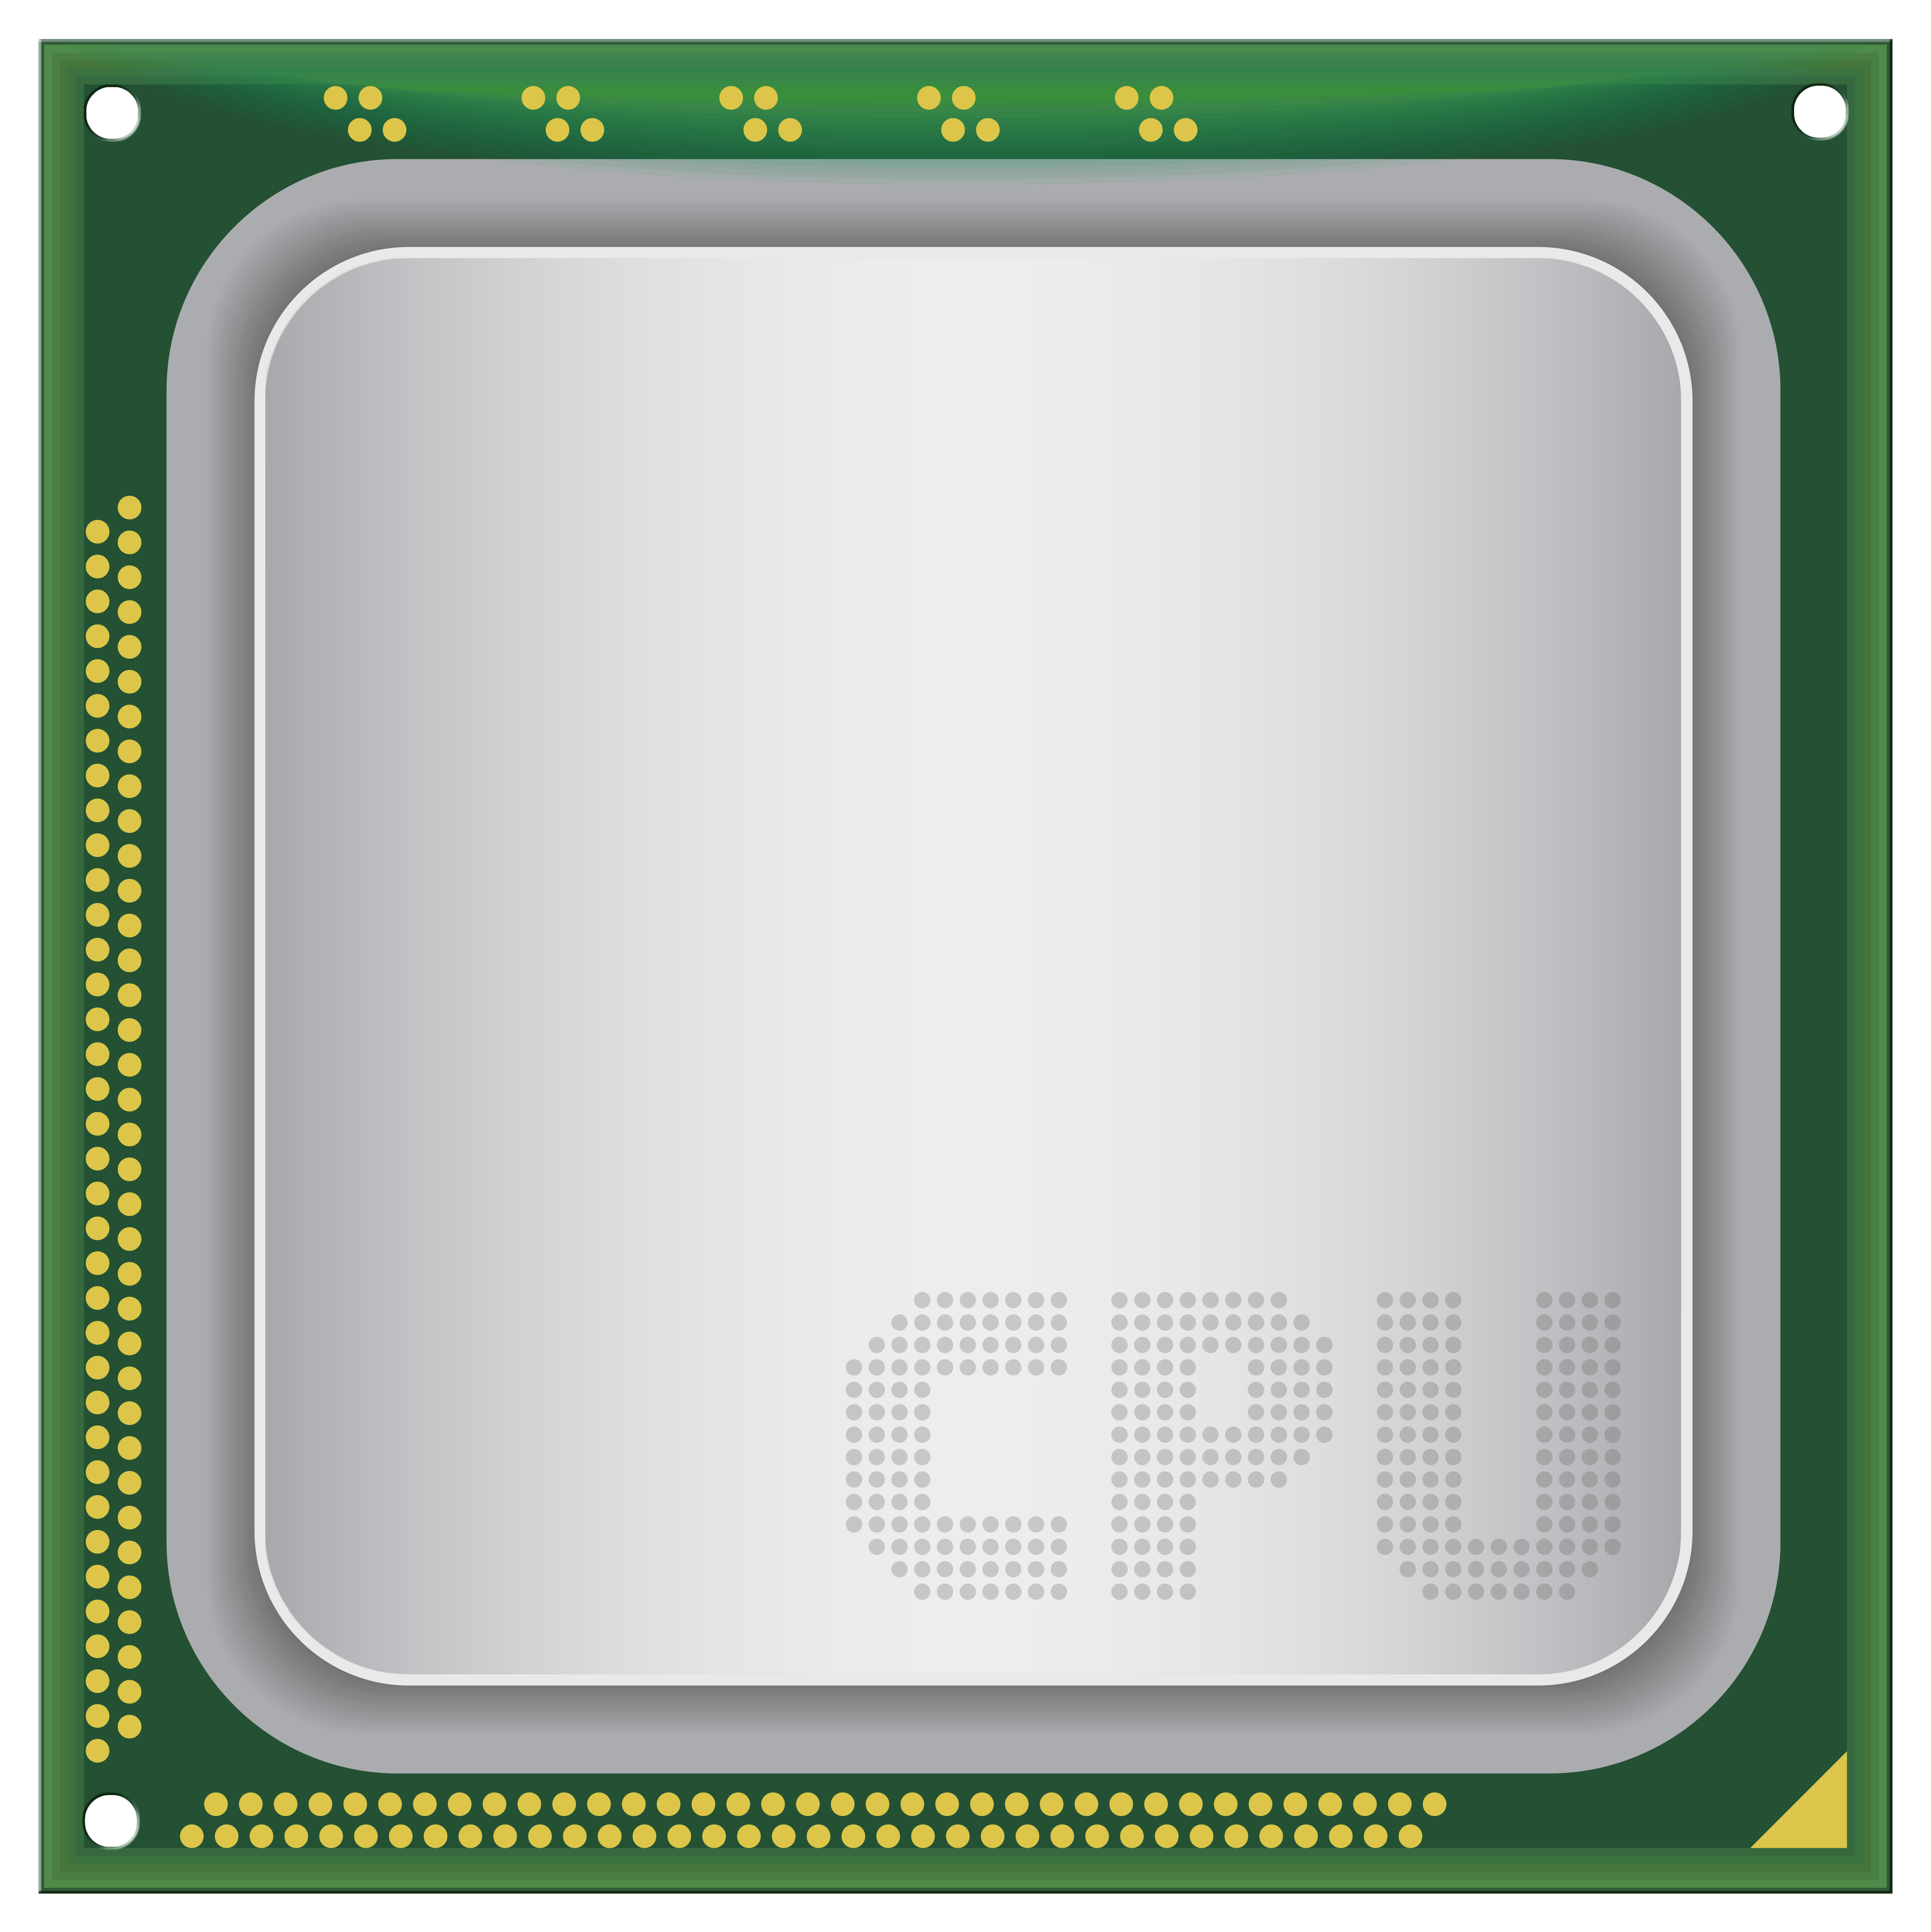
CONSTRUCTING A CPU DIAGRAM
The CPU:
Central Processing Unit
The brain of the computer
Carries out majority of processing inside of a device
CPU has two main components: CU & ALU
https://images.hothardware.com/contentimages/article/3176/content/small_nvidia-ga106-gpu-die.jpg

Slide 15
CONSTRUCTING A CPU DIAGRAM
The CU:
Control Unit
Directs CPU operations
Directs computer memory, ALU, input and output devices
The “boss” of the CPU
Control Unit
https://images.hothardware.com/contentimages/article/3176/content/small_nvidia-ga106-gpu-die.jpg

Slide 16
CONSTRUCTING A CPU DIAGRAM
The ALU:
Arithmetic logic unit
Performs arithmetic and logic
Addition, subtraction, multiplication, division
AND, OR, NOT, XOR
Arithmetic Logic Unit
Control Unit
https://images.hothardware.com/contentimages/article/3176/content/small_nvidia-ga106-gpu-die.jpg

Slide 17
CONSTRUCTING A CPU DIAGRAM
Registers:
Small amounts of storage available directly on CPU
Hold data the CPU is directly working with
5 important ones:
Instruction, Program Counter, Memory Address, Memory Data, and Accumulator
Registers
Arithmetic Logic Unit
Control Unit
https://images.hothardware.com/contentimages/article/3176/content/small_nvidia-ga106-gpu-die.jpg

Slide 18
CONSTRUCTING A CPU DIAGRAM
Instruction Register:
When an instruction is fetched from memory, it is held in the IR
Holds instruction CPU is currently executing
Registers
Arithmetic Logic Unit
IR
Control Unit
https://images.hothardware.com/contentimages/article/3176/content/small_nvidia-ga106-gpu-die.jpg

Slide 19
CONSTRUCTING A CPU DIAGRAM
Program Counter:
Holds address of the next instruction to be fetched from memory
Once the instruction is fetched, PC updates to the next one needed
Registers
Arithmetic Logic Unit
IR
PC
Control Unit
https://images.hothardware.com/contentimages/article/3176/content/small_nvidia-ga106-gpu-die.jpg

Slide 20
CONSTRUCTING A CPU DIAGRAM
Memory Address Register:
Holds memory address currently being fetched
Content from PC is copied to MAR
MAR provides address to memory to get data and instructions
Registers
Arithmetic Logic Unit
IR
PC
MAR
Control Unit
https://images.hothardware.com/contentimages/article/3176/content/small_nvidia-ga106-gpu-die.jpg

Slide 21
CONSTRUCTING A CPU DIAGRAM
Memory Data Register:
Holds data that has been fetched, or is about to be written back into memory at the address in the MAR
Registers
Arithmetic Logic Unit
IR
PC
MAR
MDR
Control Unit
https://images.hothardware.com/contentimages/article/3176/content/small_nvidia-ga106-gpu-die.jpg

Slide 22
CONSTRUCTING A CPU DIAGRAM
Accumulator:
Stores intermediate arithmetic or logical results produced by the ALU
Registers
Arithmetic Logic Unit
IR
PC
MAR
AC
MDR
Control Unit
https://images.hothardware.com/contentimages/article/3176/content/small_nvidia-ga106-gpu-die.jpg

Slide 23
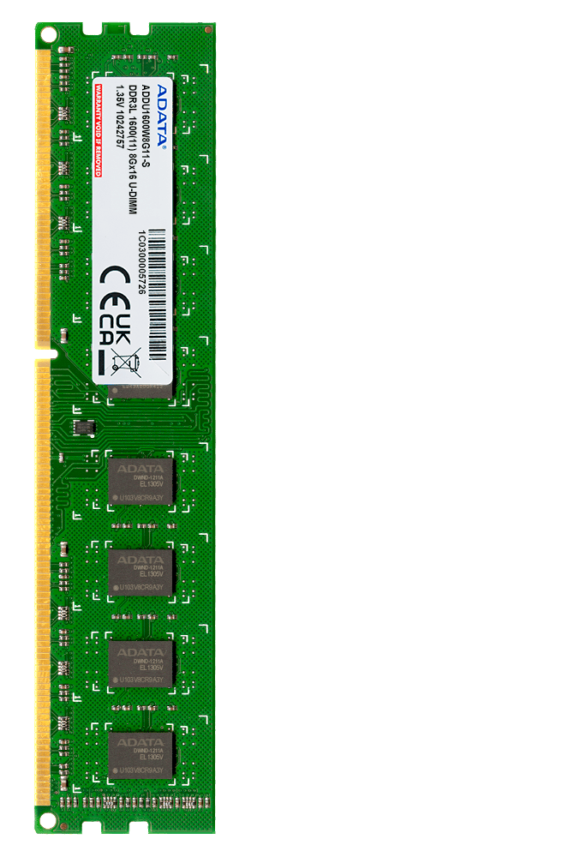
CONSTRUCTING A CPU DIAGRAM
Let’s go ahead and add some memory to our diagram for the next step
Registers
Arithmetic Logic Unit
IR
PC
MAR
AC
MDR
Control Unit
https://images.hothardware.com/contentimages/article/3176/content/small_nvidia-ga106-gpu-die.jpg

Slide 24
CONSTRUCTING A CPU DIAGRAM
Now, let’s add the buses
Buses transfer data between various devices, including the CPU, memory, storage, and peripherals
Registers
Arithmetic Logic Unit
IR
PC
MAR
AC
MDR
Control Unit
https://images.hothardware.com/contentimages/article/3176/content/small_nvidia-ga106-gpu-die.jpg

Slide 25
CONSTRUCTING A CPU DIAGRAM
Buses have widths measured in bits
More width = more data at a time
Registers
Arithmetic Logic Unit
IR
PC
MAR
AC
MDR
Control Unit
https://images.hothardware.com/contentimages/article/3176/content/small_nvidia-ga106-gpu-die.jpg

Slide 26
CONSTRUCTING A CPU DIAGRAM
Control Bus:
Transmit control signals to and from CPU
This bus is bidirectional, as it sends & receives
Read/Write Operations
Interrupts
Synchronization
Registers
Arithmetic Logic Unit
IR
PC
MAR
AC
MDR
Control Bus
Control Unit
https://images.hothardware.com/contentimages/article/3176/content/small_nvidia-ga106-gpu-die.jpg

Slide 27
CONSTRUCTING A CPU DIAGRAM
Data Bus:
Carries data between CPU, memory, peripherals
Width determines speed of data transfer
Data read from and written to memory – bidirectional
Size is often 8,16,32,64
Registers
Arithmetic Logic Unit
IR
PC
MAR
AC
MDR
Control Bus
Control Unit
Data Bus
https://images.hothardware.com/contentimages/article/3176/content/small_nvidia-ga106-gpu-die.jpg

Slide 28
CONSTRUCTING A CPU DIAGRAM
Address Bus
Transmit address to read from or write to in memory
Width of address bus determines system memory capacity
32 bit bus = 2³² memory locations
Unidirectional
Registers
Arithmetic Logic Unit
IR
PC
MAR
AC
MDR
Control Bus
Address Bus
Control Unit
Data Bus
https://images.hothardware.com/contentimages/article/3176/content/small_nvidia-ga106-gpu-die.jpg

Slide 29
CONSTRUCTING A CPU DIAGRAM
Where does the data carried in on the data bus go?
Registers
Arithmetic Logic Unit
IR
PC
MAR
AC
MDR
Control Bus
Address Bus
Control Unit
Data Bus
https://images.hothardware.com/contentimages/article/3176/content/small_nvidia-ga106-gpu-die.jpg

Slide 30
CONSTRUCTING A CPU DIAGRAM
Where do the addresses carried in on the address bus go?
Registers
Arithmetic Logic Unit
IR
PC
MAR
AC
MDR
Control Bus
Address Bus
Control Unit
Data Bus
https://images.hothardware.com/contentimages/article/3176/content/small_nvidia-ga106-gpu-die.jpg

Slide 31
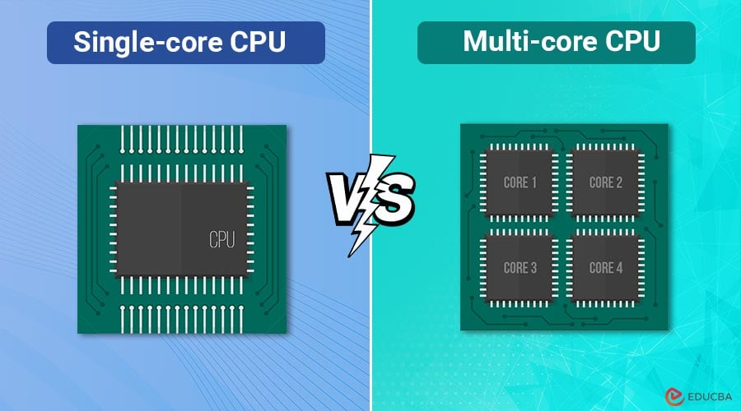
PROCESSOR TYPES
So far, we’ve looked a single core processor, meaning it can only handle one task at a time
These are useful in low end machines but are uncommon nowadays
Best for tasks that don’t require multitasking
To multitask, the CPU has to share time between programs
https://images.hothardware.com/contentimages/article/3176/content/small_nvidia-ga106-gpu-die.jpg

Slide 32
PROCESSOR TYPES
Multi-core CPUs have multiple cores (think of them as multiple mini CPUs)
Performance is faster than single core
Ideal for multitasking, gaming, servers
Software has to be written to take advantage of multi-cores
Old software often sees no benefit
https://images.hothardware.com/contentimages/article/3176/content/small_nvidia-ga106-gpu-die.jpg

Slide 33
PROCESSOR TYPES
Parallel processors are like multi-core systems, but instead each processor has a separate job that it’s good at
An instance of parallel processing is the GPU, which we’ll talk about next
https://images.hothardware.com/contentimages/article/3176/content/small_nvidia-ga106-gpu-die.jpg

Slide 34
BREAK TIME
Take a quick 10 minute break before we get back to it!
https://images.hothardware.com/contentimages/article/3176/content/small_nvidia-ga106-gpu-die.jpg

Slide 35
THE GPU
The Graphics Processing Unit is a co-processor to the CPU
It’s specialized to render images, videos, and animations by performing rapid mathematical calculations
The structure of a GPU consists of thousands of small, efficient cores, allowing for efficient multitasking
Each of these squares has multiple cores
https://images.hothardware.com/contentimages/article/3176/content/small_nvidia-ga106-gpu-die.jpg

Slide 36

THE GPU
Originally, GPUs were created for video games and rendering, but they have been adopted widely for research, machine learning, AI, and cryptocurrency mining
Applying shaders, textures, and lighting to 3D models
GPUs are also efficient at encoding and decoding video files
https://www.aorus.com/upload/Product/F_20201230135856TD1TZv.JPG

Slide 37

THE GPU
AI and Machine Learning
Because AI and Machine Learning require many computations, and GPUs are good at making many computations, they are very effective at this task
Often, multiple GPUs will be run in parallel to maximize efficiency
https://striking-kindness-e0d93214bb.media.strapiapp.com/Create_a_captivating_and_creative_cover_image_for_an_article_titled_Top_Free_AI_Tools_The_artwork_should_feature_a_female_face_with_the_brain_visib_d56eabd6f9.png

Slide 38

THE GPU
Blockchain & Cryptocurrency
Because GPUs outperform CPUs at solving cryptographic puzzles, they are used to mine cryptocurrency
This book was clearly written a few years ago lol this isn’t relevant anymore
This led to big shortages in the early 2020s, which have been replaced by AI-driven shortages
https://www.dunhamandcompany.com/wp-content/uploads/2020/05/GettyImages-1034363382-e1589830000885.jpg

Slide 39
THE GPU
Pull the script “A1-CPU-vs-GPU-efficiency.py” off of the Resources tab on GitHub and run it to see real time how much more efficient the parallel nature of GPU tasks can be
https://www.dunhamandcompany.com/wp-content/uploads/2020/05/GettyImages-1034363382-e1589830000885.jpg

Slide 40
THE GPU
Check out this video
NVIDIA GPU vs CPU. 'Mythbusters' stars paint the Mona Lisa in 80 Milliseconds!
https://www.dunhamandcompany.com/wp-content/uploads/2020/05/GettyImages-1034363382-e1589830000885.jpg

Slide 41
THE GPU
With this said, why don’t we use the GPU for everything?
https://www.dunhamandcompany.com/wp-content/uploads/2020/05/GettyImages-1034363382-e1589830000885.jpg

Slide 42
THE GPU
With this said, why don’t we use the GPU for everything?
https://www.dunhamandcompany.com/wp-content/uploads/2020/05/GettyImages-1034363382-e1589830000885.jpg

Slide 43
THE GPU
The GPU tends to be worse at tasks that aren’t parallelizable
Loading your operating system, running a single decision, branching program
https://www.dunhamandcompany.com/wp-content/uploads/2020/05/GettyImages-1034363382-e1589830000885.jpg

Slide 44
HL ONLY
CPU AND GPU COMPARISON
HL people, pair up for an activity
https://www.dunhamandcompany.com/wp-content/uploads/2020/05/GettyImages-1034363382-e1589830000885.jpg

Slide 45
HL ONLY
CPU AND GPU COMPARISON
Compare and contrast the following topics for CPU and GPU using a venn diagram in your groups – 10 minutes
Group 1
Design philosophy
Core architecture
Group 2
Memory Access
Power Efficiency
Feel free to do this on your notes or on a table, or a piece of paper idc
https://www.dunhamandcompany.com/wp-content/uploads/2020/05/GettyImages-1034363382-e1589830000885.jpg

Slide 46
HL ONLY
CPU AND GPU COMPARISON
Now share your research!
https://www.dunhamandcompany.com/wp-content/uploads/2020/05/GettyImages-1034363382-e1589830000885.jpg

Slide 47
HL ONLY
CPU AND GPU COMPARISON
Almost all modern devices have both a CPU and a GPU, even if the GPU is very small
How would you divide labor between the coprocessors if you were the CPU? Answer this in your notes
https://www.dunhamandcompany.com/wp-content/uploads/2020/05/GettyImages-1034363382-e1589830000885.jpg

Slide 48
LVB
Q1. Identify the register that holds the address of the next instruction to be executed. [1]
Q2. Describe the function of the Control Unit (CU) and explain how it differs from the Arithmetic Logic Unit (ALU). [2]
Q3. Construct a labelled diagram showing the ALU, CU, and the five specified registers (IR, PC, MAR, MDR, AC), with the address, data, and control buses connecting the CPU to memory. [3]
Q4. Compare the design goals of a CPU and a GPU, referring to at least one real-world scenario where a GPU's architecture provides a clear advantage. [2]

Slide 49

VOCABULARY TO REMEMBER
CPU
CU
ALU
IR
MAR
MDR
AC
PC
GPU
Multi-core system
Single-core system
Parallel computing

